Slide 1

WEB PROGRAMMING LAB JAVASCRIPT
MCA 3RD SEMESTER
SIKKIM UNIVERSITY
8TH NOV 2022

Slide 2
BASICS OF JAVASCRIPT
JavaScript (js) is a light-weight object-oriented programming language which is used by several websites for scripting the webpages.
It is an interpreted, full-fledged programming language that enables dynamic interactivity on websites when applied to an HTML document.
It was introduced in the year 1995 for adding programs to the webpages in the Netscape Navigator browser.
Since then, it has been adopted by all other graphical web browsers.
With JavaScript, users can build modern web applications to interact directly without reloading the page every time.
The traditional website uses js
Although, JavaScript has no connectivity with Java programming language.
The name was suggested and provided in the times when Java was gaining popularity in the market.
In addition to web browsers, databases such as CouchDB and MongoDB uses JavaScript as their scripting and query language. to provide several forms of interactivity and simplicity.

Slide 3
FEATURES OF JAVASCRIPT
All popular web browsers support JavaScript as they provide built-in execution environments.
JavaScript follows the syntax and structure of the C programming language. Thus, it is a structured programming language.
JavaScript is a weakly typed language, where certain types are implicitly cast (depending on the operation).
JavaScript is an object-oriented programming language that uses prototypes rather than using classes for inheritance.
It is a light-weighted and interpreted language.
It is a case-sensitive language.
JavaScript is supportable in several operating systems including, Windows, macOS, etc.
It provides good control to the users over the web browsers.

Slide 4
APPLICATION OF JAVASCRIPT
JavaScript is used to create interactive websites. It is mainly used for:
Client-side validation,
Dynamic drop-down menus,
Displaying date and time,
Displaying pop-up windows and dialog boxes (like an alert dialog box, confirm dialog box and prompt dialog box),
Displaying clocks etc.

Slide 5
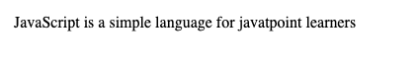
JAVASCRIPT EXAMPLE
JavaScript provides 3 places to put the JavaScript code:
within body tag,
within head tag and
external JavaScript file.
<script type="text/javascript">
document.write("JavaScript is a simple language for javatpoint learners");
</script>
OUTPUT:-
The script tag specifies that we are using JavaScript.
The text/javascript is the content type that provides information to the browser about the data.
The document.write() function is used to display dynamic content through JavaScript.

Slide 6
JAVASCRIPT EXAMPLE : CODE BETWEEN THE BODY TAG
A simple example of JavaScript that displays alert dialog box.
<html>
<body>
<script type="text/javascript">
alert("Hello Javatpoint");
</script>
</body>
</html>

Slide 7
JAVASCRIPT EXAMPLE : CODE BETWEEN THE HEAD TAG
Let’s see the same example of displaying alert dialog box of JavaScript that is contained inside the head tag.
In this example, we are creating a function msg(). To create function in JavaScript, you need to write function with function_name as given below.
To call function, you need to work on event.
Here we are using onclick event to call msg() function.
<html>
<head>
<script type="text/javascript">
function msg(){
alert("Hello Javatpoint");
}
</script>
</head>
<body>
<p>Welcome to Javascript</p>
<form>
<input type="button" value="click" onclick="msg()"/>
</form>
</body>
</html>

Slide 8
EXTERNAL JAVASCRIPT FILE
We can create external JavaScript file and embed it in many html page.
It provides code re usability because single JavaScript file can be used in several html pages.
An external JavaScript file must be saved by .js extension. It is recommended to embed all JavaScript files into a single file. It increases the speed of the webpage.
Let's create an external JavaScript file that prints Hello Javatpoint in a alert dialog box.
Index.html
<html>
<head>
<script type="text/javascript" src="message.js"></script>
</head>
<body>
<p>Welcome to JavaScript</p>
<form>
<input type="button" value="click" onclick="msg()"/>
</form>
</body>
</html>
message.js
function msg(){
alert("Hello Javatpoint");
}

Slide 9

PROGRAMS USING JAVASCRIPT

Slide 10
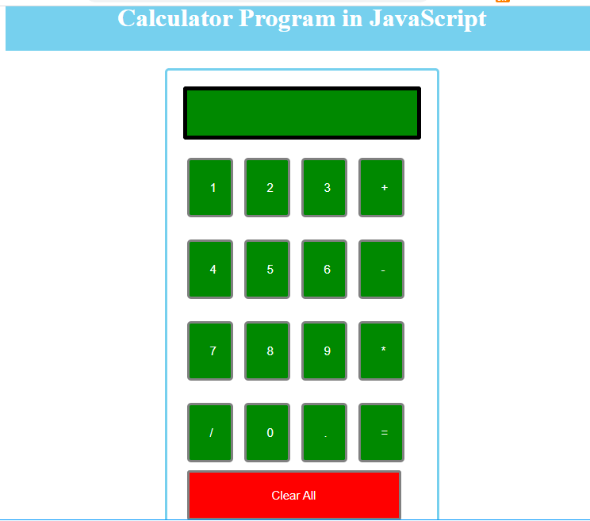
Write JavaScript to build a calculator with addition, subtraction, multiplication and division operations.
Modify the calculator include power, squareroot, cuberoot and log operations.

Slide 11
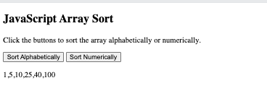
3. Write JavaScript to sort elements in an array

Slide 12
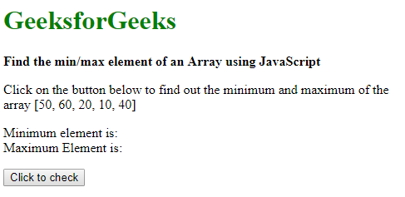
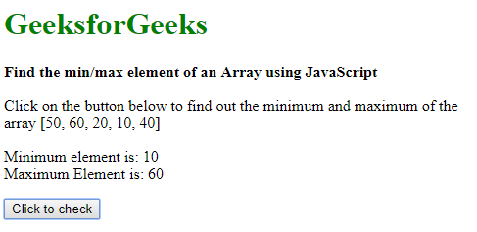
BEFORE CLICKING
4. Write JavaScript to find maximum and minimum element in a given 1D array
AFTER CLICKING

Slide 13
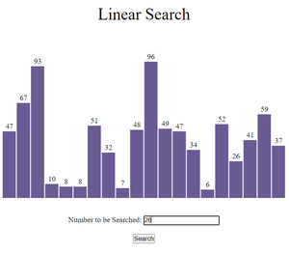
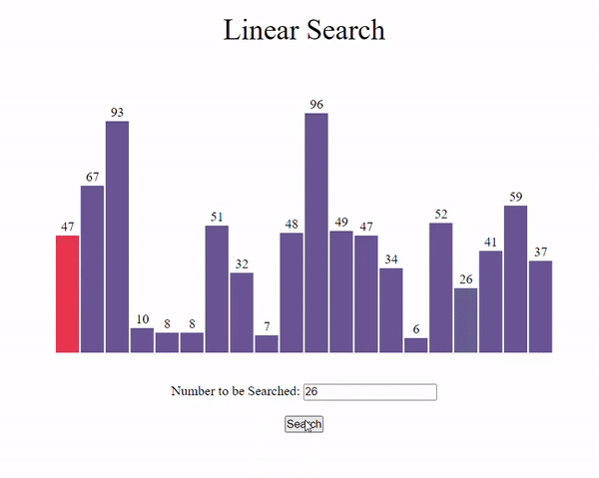
5. Write JavaScript to search an element in a given 1D array using Linear Search technique.
Before Search
Search process

Slide 14
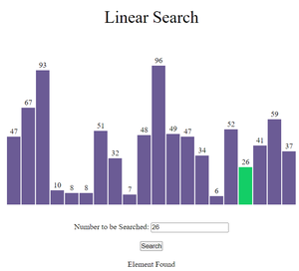
After Search

Slide 15
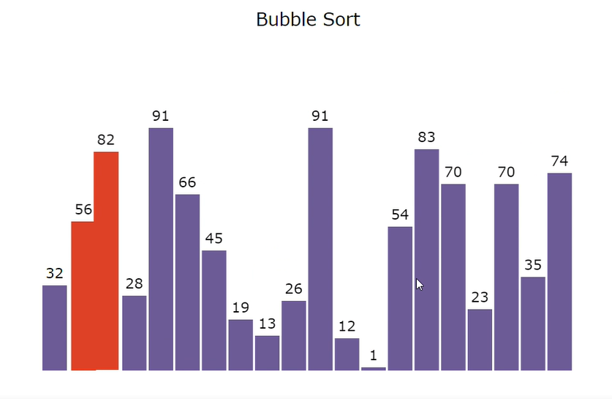
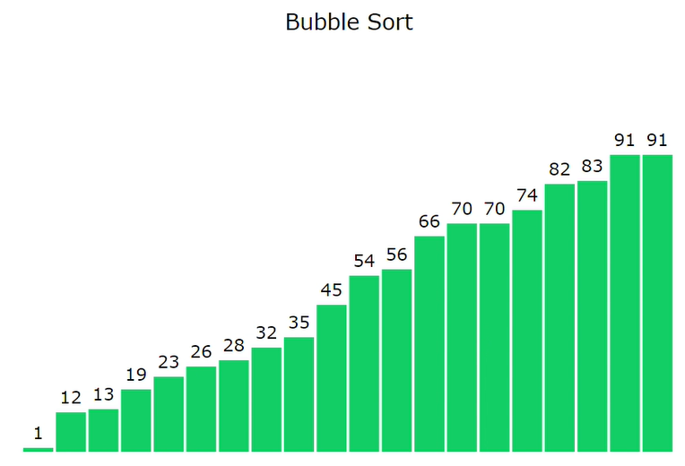
6. Write JavaScript to sort elements in a given 1D array using Bubble Sort technique.
After Sorting
Before Sorting

Slide 16
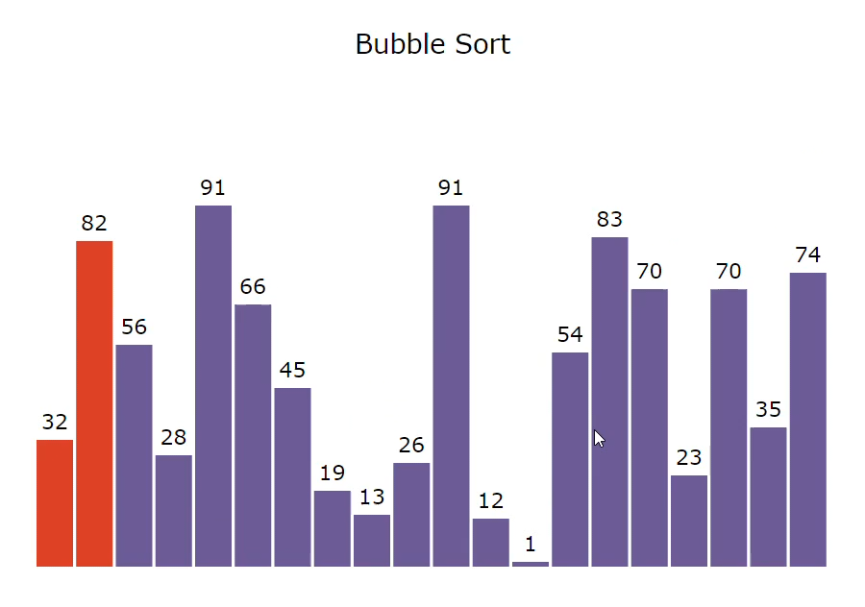
Bubble Sort Procedure

Slide 17
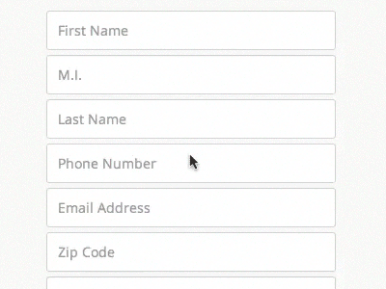
JAVASCRIPT FORM VALIDATION

Slide 18
JAVASCRIPT FORM VALIDATION
It is important to validate the form submitted by the user because it can have inappropriate values.
So, validation is must to authenticate user.
JavaScript provides facility to validate the form on the client-side so data processing will be faster than server-side validation.
Most of the web developers prefer JavaScript form validation.
Through JavaScript, we can validate name, password, email, date, mobile numbers and more fields.

Slide 19
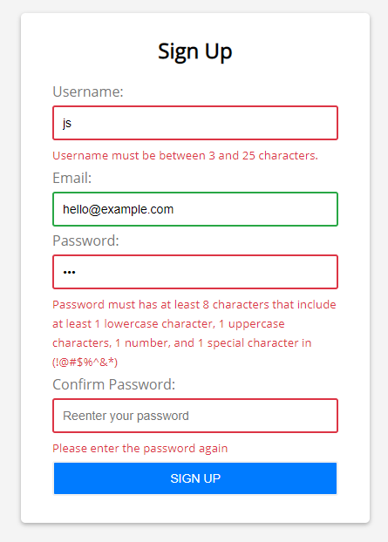
JAVASCRIPT FORM VALIDATION
If we have a simple signup form with four input fields: username, email, password, and confirm password.
Then we can click the sign up without filling anything or filling incorrect data format, the form will show error messages:
We can validate the following:
Username cannot be blank and has at least 3 characters and cannot be longer than 25 characters.
Email is mandatory and valid.
Password has eight characters or longer. And it must contain 1 lowercase character, 1 uppercase character, 1 number, and at least one special character in this set (!@#$%^&*).
The confirm password must be the same as the password.

Slide 20
JAVASCRIPT FORM VALIDATION EXAMPLE
In the example in next slide, we are going to validate the name and password.
The name can’t be empty and password can’t be less than 6 characters long.
Here, we are validating the form on form submit.
The user will not be forwarded to the next page until given values are correct.

Slide 21
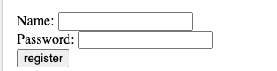
JAVASCRIPT FORM VALIDATION EXAMPLE
<html>
<body>
<script>
function validateform(){
var name=document.myform.name.value;
var password=document.myform.password.value;
if (name==null || name==""){
alert("Name can't be blank");
return false;
}else if(password.length<6){
alert("Password must be at least 6 characters long.");
return false;
}
}
</script>
<body>
<form name="myform" method="post" action="http://www.javatpoint.com/javascriptpages/valid.jsp" onsubmit="return validateform()" >
Name: <input type="text" name="name"><br/>
Password: <input type="password" name="password"><br/>
<input type="submit" value="register">
</form>
</body>
</html>

Slide 22
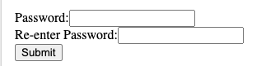
JAVASCRIPT RETYPE PASSWORD FORM EXAMPLE
<!DOCTYPE html>
<html>
<head>
<script type="text/javascript">
function matchpass(){
var firstpassword=document.f1.password.value;
var secondpassword=document.f1.password2.value;
if(firstpassword==secondpassword){
return true;
}
else{
alert("password must be same!");
return false;
}}
</script>
</head>
<body>
<form name="f1" action="http://www.javatpoint.com/javascriptpages/valid.jsp" onsubmit="return matchpass()">
Password:<input type="password" name="password" /><br/>
Re-enter Password:<input type="password" name="password2"/><br/>
<input type="submit">
</form>
</body>
</html>

Slide 23
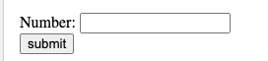
JavaScript Number Validation
<!DOCTYPE html>
<html>
<head>
<script>
function validate(){
var num=document.myform.num.value;
if (isNaN(num)){
document.getElementById("numloc").innerHTML="Enter Numeric value only";
return false;
}else{
return true;
}}
</script>
</head>
<body>
<form name="myform" action="http://www.javatpoint.com/javascriptpages/valid.jsp" onsubmit="return validate()" >
Number: <input type="text" name="num"><span id="numloc"></span><br/>
<input type="submit" value="submit">
</form>
</body>
</html>
Let's validate the textfield for numeric value only. Here, we are using isNaN() function.

Slide 24
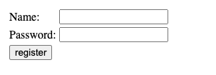
JavaScript validation with image
Let’s see an interactive JavaScript form validation example that displays correct and incorrect image if input is correct or incorrect.

Slide 25
<html>
<body>
<script type="text/javascript">
function validate(){
var name=document.f1.name.value;
var passwordlength=document.f1.password.value.length;
var status=false;
if(name==""){
document.getElementById("namelocation").innerHTML=
" <img src='http://www.javatpoint.com/javascriptpages/images/unchecked.gif'/> Please enter your name";
status=false;
}else{
document.getElementById("namelocation").innerHTML=" <img src='http://www.javatpoint.com/javascriptpages/images/checked.gif'/>";
status=true;
}
if(passwordlength<6){
document.getElementById("passwordlocation").innerHTML=
" <img src='http://www.javatpoint.com/javascriptpages/images/unchecked.gif'/> Password must be greater than 6";
status=false;
}else{
document.getElementById("passwordlocation").innerHTML=" <img src='http://www.javatpoint.com/javascriptpages/images/checked.gif'/>";
}
return status;
}

Slide 26
</script>
<form name="f1" action="http://www.javatpoint.com/javascriptpages/valid.jsp" onsubmit="return validate()">
<table>
<tr><td>Name:</td><td><input type="text" name="name"/>
<span id="namelocation" style="color:red"></span></td></tr>
<tr><td>Password:</td><td><input type="password" name="password"/>
<span id="passwordlocation" style="color:red"></span></td></tr>
<tr><td colspan="2"><input type="submit" value="register"/> </td></tr>
</table>
</form>
</body>
</html>

Slide 27
JavaScript email validation
We can validate the email by the help of JavaScript.
There are many criteria that need to be follow to validate the email id such as:
email id must contain the @ and . character
There must be at least one character before and after the @.
There must be at least two characters after . (dot).
Let's see the simple example to validate the email field.

Slide 28
<html>
<body>
<script>
function validateemail()
{
var x=document.myform.email.value;
var atposition=x.indexOf("@");
var dotposition=x.lastIndexOf(".");
if (atposition<1 || dotposition<atposition+2 || dotposition+2>=x.length){
alert("Please enter a valid e-mail address \n atpostion:"+atposition+"\n dotposition:"+dotposition);
return false;
}
}
</script>
<body>
<form name="myform" method="post" action="http://www.javatpoint.com/javascriptpages/valid.jsp" onsubmit="return validateemail();">
Email: <input type="text" name="email"><br/>
<input type="submit" value="register">
</form>
</body>
</html>

Slide 29
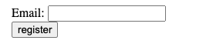
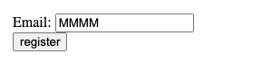
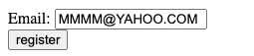
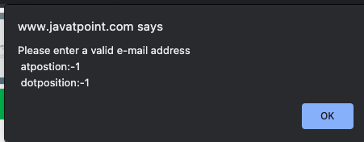
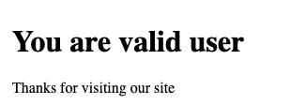
INVALID EMAIL EXAMPLE
VALID EMAIL EXAMPLE

Slide 30
CHECKBOX VALIDATION
To find out if a checkbox is ticked or not, you can access the checked attribute on the checkbox input. Here's an example:
HTML FILE
<input type="checkbox" id="terms"> <label for="terms">I agree to the terms and conditions</label>
JAVASCRIPT FILE
const terms = document.getElementById('terms'); if (!terms.checked) { alert('Please agree to the terms and conditions to proceed further.'); }

Slide 31
SELECT INPUT / DROPDOWN VALIDATION
The <select> HTML element is used to create a drop-down list.
The <option> tags inside the <select> element define the available options in the drop-down list.
Each of these <option> tags have a value attribute associated with them.
For the default or initial option, you can set its value to be an empty string so that it'll be deemed as an invalid option.
For all the other options, set an appropriate value attribute.
Here's an example of how you can validate a <select> input element:
HTML FILE
<select id="title" required> <option value="">Select One</option> <option value="Mr">Mr</option> <option value="Mrs">Mrs</option> <option value="Ms">Ms</option> </select>
JAVASCRIPT FILE
const title = document.getElementById('title'); if (title.value = "") { alert('Please select a title'); }

Slide 32
QUESTION.
EXECUTE THE FORM VALIDATION CODE.
IMPLEMENT FORM VALIDATION ON ALL PAGES OF YOUR PROJECT

